Slide 1
ECE 532
CHAPTER 2: FUNDAMENTAL DATA STRUCTURES: STACKS AND QUEUES (PART 1: STACKS)
Lecturer: Dr. Roslina Mohamad
Room: Tower 2, Level 13, No:14C

Slide 2
Learning Outcomes
At the end of this lecture, you will be able to:
Learn about stacks
Examine various stack operations
Learn how to implement a stack as an array
Learn how to implement a stack as a linked list

Slide 3
Stacks
Stack: list of homogenous elements
Addition and deletion occur only at one end, called the top of the stack
Example: in a cafeteria, the second tray can be removed only if first tray has been removed
Last in first out (LIFO) data structure
Operations:
Push: to add an element onto the stack
Pop: to remove an element from the stack

Slide 4
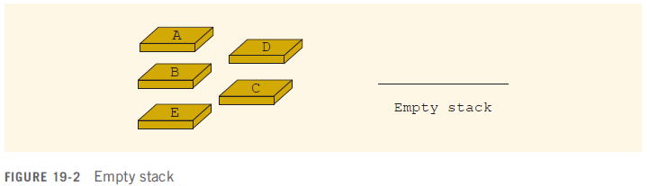
Stacks

Slide 5
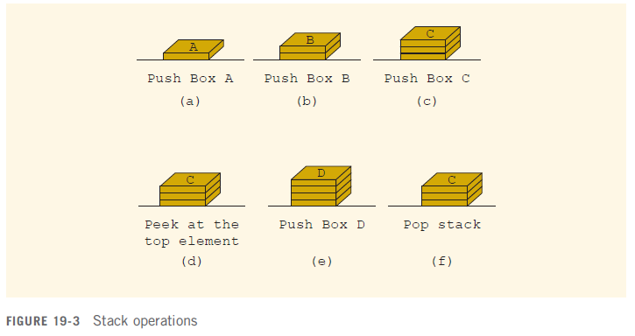
Stacks

Slide 6
Stack Basics
Stack is usually implemented as a list, with additions and removals taking place at one end of the list
The active end of the list implementing the stack is the top of the stack
Stack types:
Static – fixed size, often implemented using an array
Dynamic – size varies as needed, often implemented using a linked list

Slide 7
Stack Operations and Functions
Operations:
push: add a value at the top of the stack
pop: remove a value from the top of the stack
Functions:
isEmpty: true if the stack currently contains no elements
isFull: true if the stack is full; only useful for static stacks

Slide 8
Empty Stack
If stackTop is 0, the stack is empty
Full Stack
The stack is full if stackTop is equal to maxStackSize

Slide 9
Push
Store the newItem in the array component indicated by stackTop
Increment stackTop
Must avoid an overflow

Slide 10
Pop
Simply decrement stackTop by 1
Must check for underflow condition

Slide 11
Static Stack Implementation
Uses an array of a fixed size
Bottom of stack is at index 0. A variable called top tracks the current top of the stack
const int STACK_SIZE = 3;
char s[STACK_SIZE];
int top = 0;
top is where the next item will be added

Slide 12
Array Implementation Example
This stack has max capacity 3, initially top = 0 and stack is empty.
K
E
G
K
E
E
push('E');
push('K');
push('G');
top is 1
top is 2
top is 3

Slide 13
Stack Operations Example
After three pops, top is 0 and the stack is empty
E
K
E
pop();
(remove G)
pop();
(remove K)
pop();
(remove E)

Slide 14
Array Implementation
char s[STACK_SIZE];
int top=0;
To check if stack is empty:
bool isEmpty()
{
if (top == 0)
return true;
else return false;
}
//See Example 2.25, Example 2.26

Slide 15
Array Implementation
char s[STACK_SIZE];
int top=0;
To check if stack is full:
bool isFull()
{
if (top == STACK_SIZE)
return true;
else return false;
}
//See Example 2.27

Slide 16
Array Implementation
To add an item to the stack
void push(char x)
{
if (isFull())
{error(); exit(1);}
// or could throw an exception
s[top] = x;
top++;
}
//See Example 2.28

Slide 17
Array Implementation
To remove an item from the stack
void pop(char &x)
{
if (isEmpty())
{error(); exit(1);}
// or could throw an exception
top--;
x = s[top];
}
//See Example 2.29 , Example 2.30

Slide 18
Linked Implementation of Stacks
Array only allows fixed number of elements
If number of elements to be pushed exceeds array size
Program may terminate
Linked lists can dynamically organize data
In a linked representation, stackTop is pointer to top element in stack

Slide 19
Dynamic Stacks
Implemented as a linked list
Can grow and shrink as necessary
Can't ever be full as long as memory is available

Slide 20
Dynamic Linked List Implementation
Define a struct for a dynamic linked list
Within the struct, define a member (s) for data and a member for dynamic nodes in the list
Define a pointer to the beginning of the linked list, which will serve as the top of the stack

Slide 21
Linked List Implementation
A linked stack after three push operations:
push(5); push(15); push(25);
25
15
5
NULL
top

Slide 22
Operations on a Linked Stack
Check if stack is empty:
bool isEmpty()
{
if (top == NULL)
return true;
else
return false;
}
//See Example 2.31

Slide 23
Push
The newElement is added at the beginning of the linked list pointed to by stackTop
We do not need to check whether the stack is full before we push an element onto the stack

Slide 24
Operations on a Linked Stack
Add a new item to the stack
void push(int value)
{
Node *temp;
temp=new Node;
temp->Data=value;
if (top == NULL)
{
top=temp;
top->next=NULL;
}
else
{
temp->next=top;
top=temp;
}
}
//See Example 2.32

Slide 25
Pop
Node pointed to by stackTop is removed

Slide 26
Operations on a Linked Stack
Remove an item from the stack
void pop()
{
Node *temp, *var=top;
if (isEmpty()==true)
{ cout<<"\nStack is empty.";
exit(1);//return;
}
else if(var==top)
{
top = top->next;
free(var);//delete var;
}
}
//See Example 2.33

